Slide 1
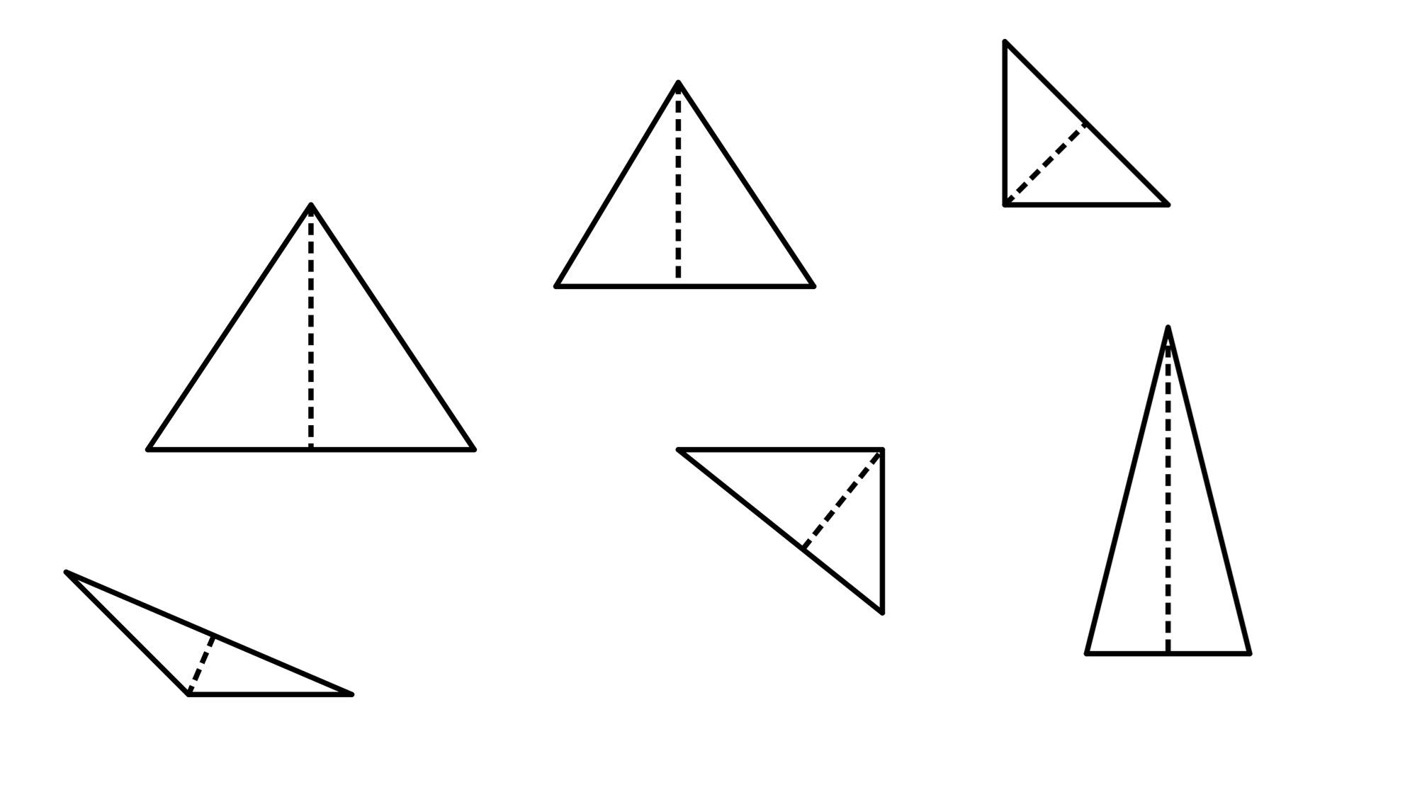
Diagonals of a rhombus
Task A: Isosceles triangles
1) Decide which of the following are isosceles triangles. If not, state why not.
a)
31°
b)
c)
74°
2.3 cm
2.3 cm
53°
59°
d)
e)
f)
73°
19 mm
4 m
4 m
73°
1.8 cm
2) Add notation marks to the diagrams, where appropriate.
a)
b)
13 cm
27°
27°
13 cm
c)
45°

Slide 2
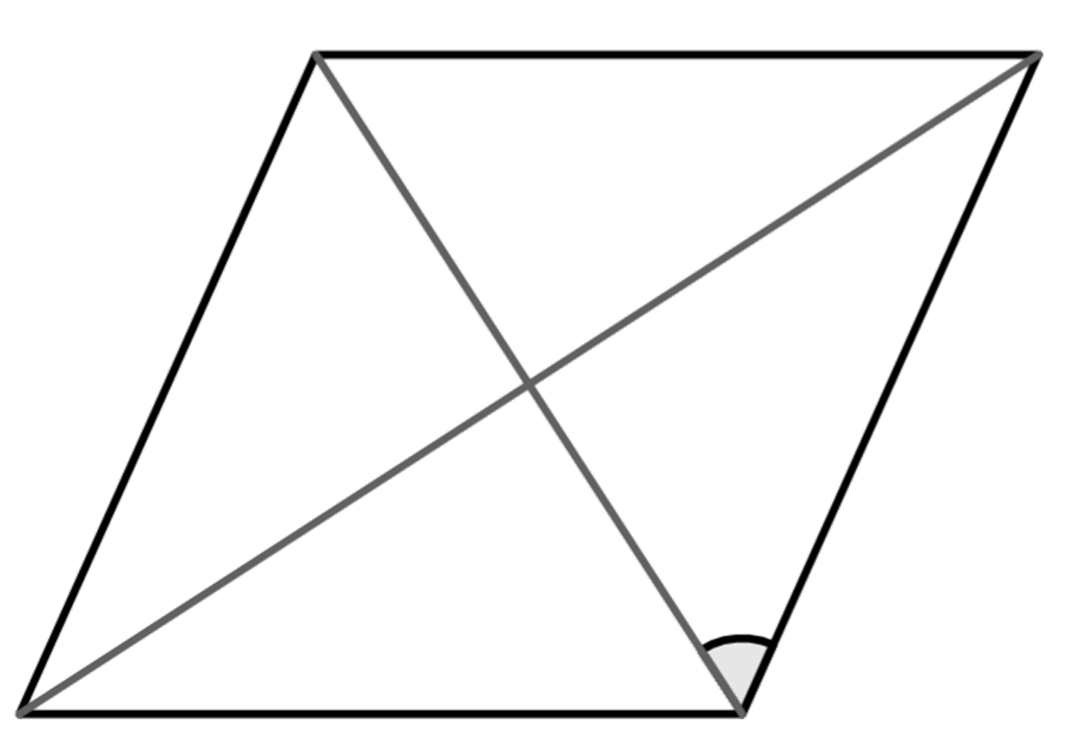
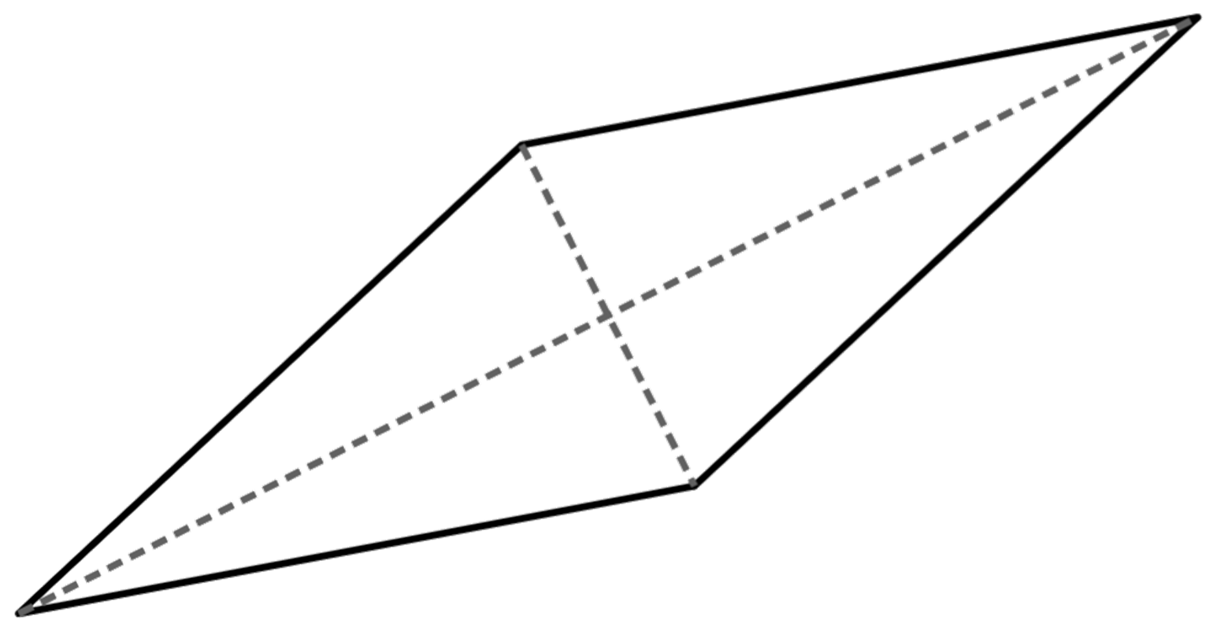
Diagonals of a rhombus
Task B: Properties of a rhombus
1) Work out the missing angles in these rhombi
a)
b°
b)
32°
a°
c°
55°
e°
d°
2) Work out the area of the rhombus in each part:
a) One diagonal is 8 cm and the other is 6 cm
b) One diagonal is 9 cm and the other is 4.5 cm
c) Half of one of the diagonals is 5 cm and the other diagonal is 1 cm
3) Construct a rhombus from this set of perpendicular lines.
Mathematics in Education and Industry.
v2.3

